Slide 1
CUSTOMER RELATIONSHIP MANAGEMENT SYSTEM
BY USING SQL
Sonali parshivnikar

Slide 2
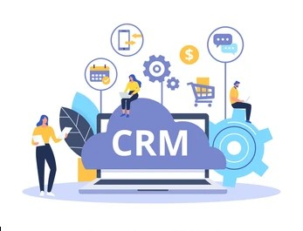
INTRODUCTION :
Built a Structured SQL-Based relational Database.
Managed CRM functional like :
- Customer data storage
- Sales tracking
- Employee role management
- Customer interaction logging
- Service ticket handling
Supports real-world queries for business insights
Improves decision-making and operational efficiency

Slide 3

PROBLEM STATEMENT :
Businesses often struggle to manage and integrate customer data, sales records, employee responsibilities, and service interactions efficiently. This project aims to solve that by developing a structured SQL-based CRM system that centralizes and organizes key operational data, enabling better customer relationship management and informed decision-making

Slide 4
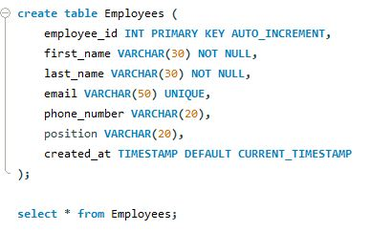
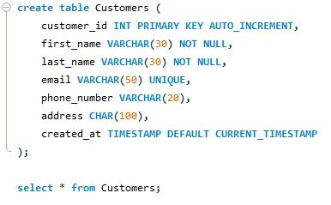
ABOUT THE DATA :
Employees Table: The Employees table stores detailed information about all employees in the organization. It includes personal details such as name, email, phone number, and job position. Each employee is uniquely identified by an employee_id. The table also records when the employee data was created.
Customer Table: The Customers table contains personal and contact information of all customers. It stores details such as name, email, phone number, and address for communication purposes. Each customer has a unique customer_id for identification. The created_at field records when the customer was added to the system.

Slide 5
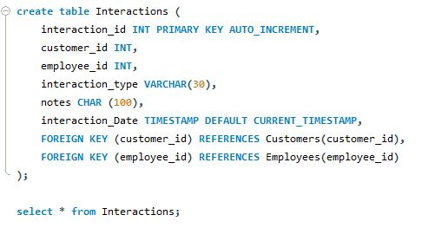
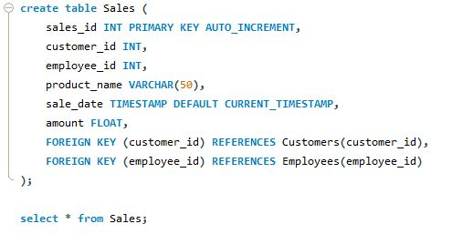
ABOUT THE DATA :
Interactions Table: The Interactions table records communication between employees and customers. It stores details such as interaction type, notes about the conversation, and the date of interaction. Each interaction is uniquely identified by interaction_id. This table helps maintain a history of customer engagement.
Sales Table: The Sales table records all sales transactions made by the company. It includes information about the product sold, sale date, and total amount of the transaction. Each sale is uniquely identified by sales_id. This table helps in tracking revenue and sales activities.

Slide 6
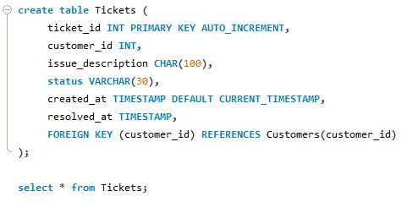
ABOUT THE DATA :
Ticket Table: The Tickets table stores customer support requests or issues reported by customers. It includes the issue description, current status of the ticket, and timestamps for creation and resolution. Each ticket has a unique ticket_id for tracking purposes. This table helps manage customer service operations.

Slide 7
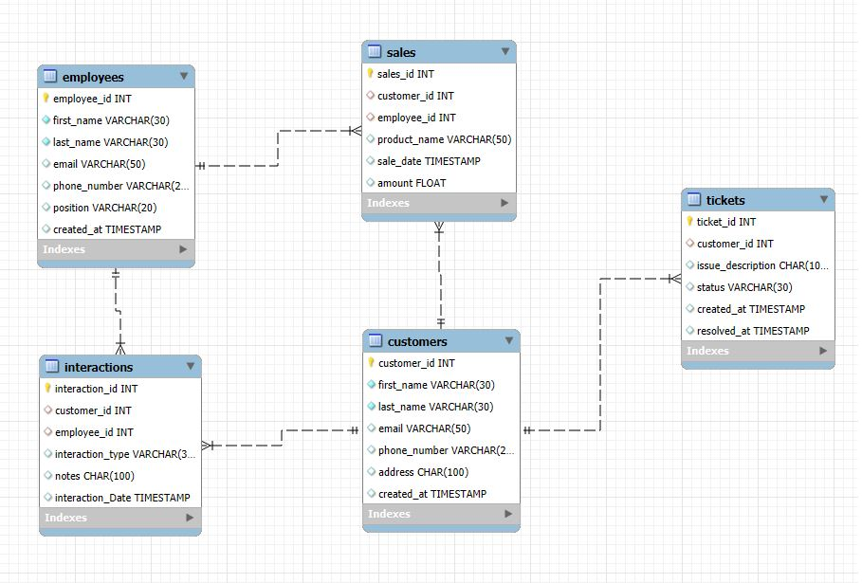
ABOUT THE DATA :

Slide 8


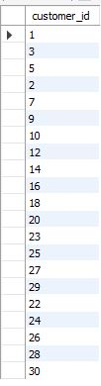
PROPOSED SOLUTION:
INSIGHTS: These are all the customers and their customer ID who have active tickets although some had multiple tickets also

Slide 9

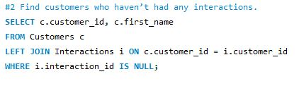
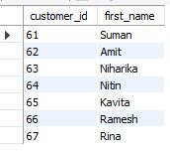
PROPOSED SOLUTION:
INSIGHTS: These are all the customers and their customer ID who haven’t had any interactions. This insight is important because it could mean two things: either they’re new and haven’t needed help yet, or worse — they signed up but didn’t engage at all.

Slide 10
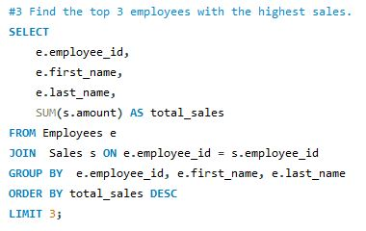


PROPOSED SOLUTION:
INSIGHTS: These are the Top 3 Employees with highest sales. This are the total sales which is arisen from multiple items.

Slide 11
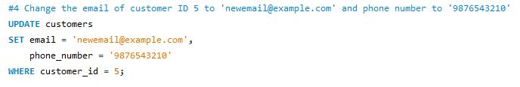
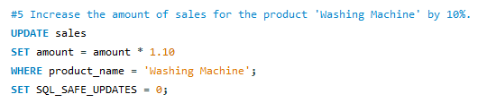
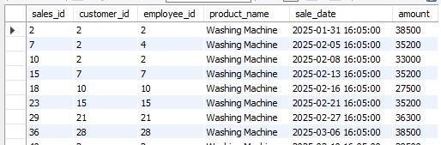
PROPOSED SOLUTION:

Slide 12
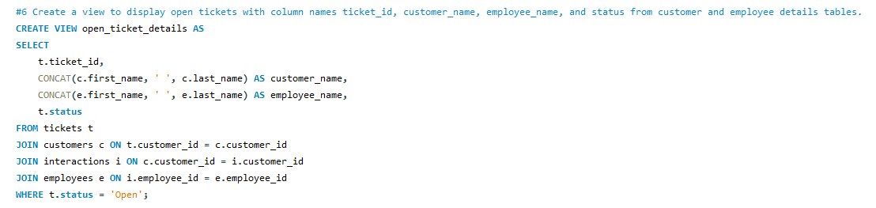
PROPOSED SOLUTION:

Slide 13
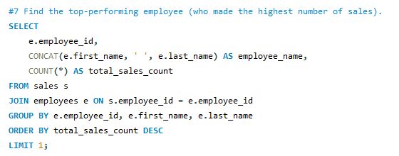


PROPOSED SOLUTION:
INSIGHTS: Ravi Kumar made the highest sales among all the employees i.e., “4

Slide 14



PROPOSED SOLUTION:
INSIGHTS: These are the total number of employees working in each position.
Sales executive have highest number of employees while Sales Manager have least number of employees.

Slide 15
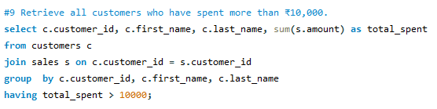

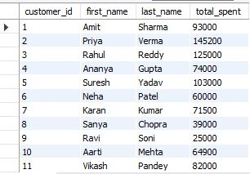
PROPOSED SOLUTION:
INSIGTS: These are all the customers who spent more that 10,000.

Slide 16
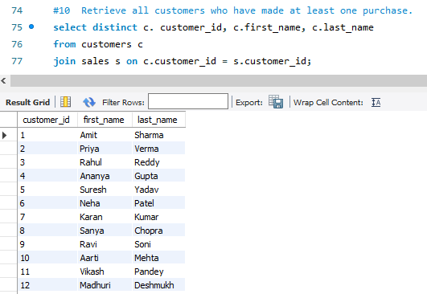
PROPOSED SOLUTION:

Slide 17
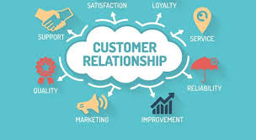
CONCLUSION :
Helps businesses build and maintain strong customer relationships.
Organizes customer data and tracks all interactions.
Analyzes behavior to understand customer needs and preferences.
Enables personalized services and improves satisfaction and
retention.
Supports data-driven decision-making and identifies key trends.
Streamlines communication and boosts operational efficiency.
Drives customer engagement and long-term business growth.

Slide 18
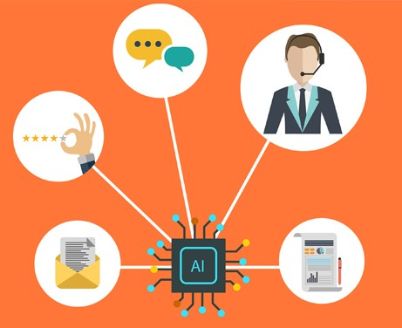
FUTURE SCOPE :
The future of Customer Relationship Management (CRM) will continue to evolve as technology advances and customer expectations grow.
AI & ML Integration: Predict customer needs, automate tasks, personalize
services.
Big Data Analysis: Deeper insights and smarter business decisions.
Multi-Channel Interaction: Seamless communication across social media,
email, and in-person.
Real-Time Personalization: Instantly tailor experiences to customer behavior.

Slide 19
THANK YOU

